Slide 1
IBM University Engagement Project Submission
“Exploring the Power of Agentic AI with IBM Granite and IBM Bob”

Slide 2

Project Tile – Smart Satellite Communication Knowledge Assistant
Domain of Project – Education
Student Name | Recent Passport Photo | Email ID | Mobile number [WhatsApp]
Yenduru Bhavana |  | vallibhavana22@gmail.com | 9390524452

Slide 3
Problem Statement -
Problem Statement : Smart Satellite Communication Knowledge Assistant
The Challenge
Satellite communication systems involve complex concepts such as frequency bands, signal modulation, link budgets, and communication protocols. Engineers and students often struggle to understand these topics because the knowledge is distributed across textbooks, research papers, and technical documentation. Finding relevant information and troubleshooting communication issues can take significant time. The challenge is to build an intelligent assistant that can retrieve knowledge and explain satellite communication concepts in an easy and interactive manner.
The Objective
Build a Satellite Communication Knowledge Assistant that helps users understand and troubleshoot satellite communication systems. The solution should:
1.Knowledge Retrieval :- Extract information from satellite communication documents and technical materials.
2.Concept Explanation :- Explain complex topics such as modulation techniques, frequency bands, and link budgets in simple language.
3.Troubleshooting Support :- Provide guidance for solving satellite communication problems.
4.Conversational Interface :- Allow users to ask questions and receive responses through an interactive chat interface.

Slide 4
Proposed Solution -
Solution
The proposed solution is an AI-powered Satellite Communication Knowledge Assistant that helps users understand satellite communication concepts, retrieve technical information, and troubleshoot communication issues through an interactive chat interface powered by IBM Granite-4 and WatsonX AI.
Key Features
Knowledge Retrieval – Retrieves relevant information from satellite communication resources.
Concept Explanation – Simplifies complex topics like link budgets, frequency bands, and modulation.
Troubleshooting Support – Provides guidance to identify and resolve communication issues.
Conversational Chat Interface – Allows users to ask questions in natural language and receive instant responses.
AI-Powered Responses – Uses IBM Granite-4 with WatsonX AI to generate accurate, context-aware answers.

Slide 5
Technology Used
IBM Bob platform -For designing and orchestrating multi-agent workflows visually
IBM Grainte model - for eg – ibm-granite-3-2-8b – For natural language understanding, reasoning, and personalization
IBM Cloud – It provides the infrastructure to build, deploy, and scale the Nutrition Agent efficiently. IBM Cloud enables a reliable, secure, and scalable environment for deploying the Nutrition Agent.

Slide 6
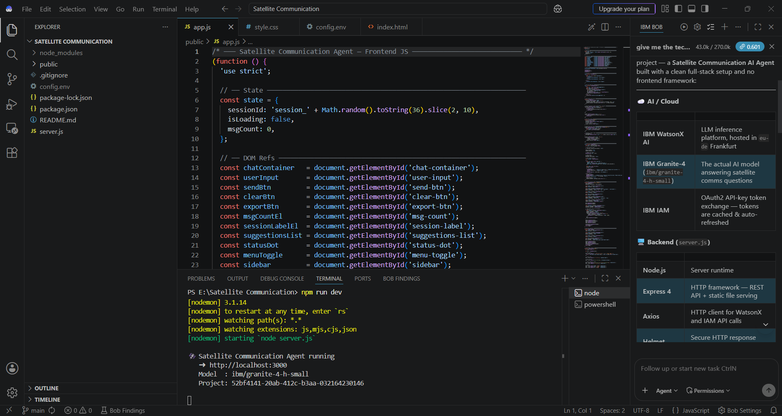
Required Files created using IBM bob -
App.py
Requirements.txt
Style.css
.env
Index.html

Slide 7
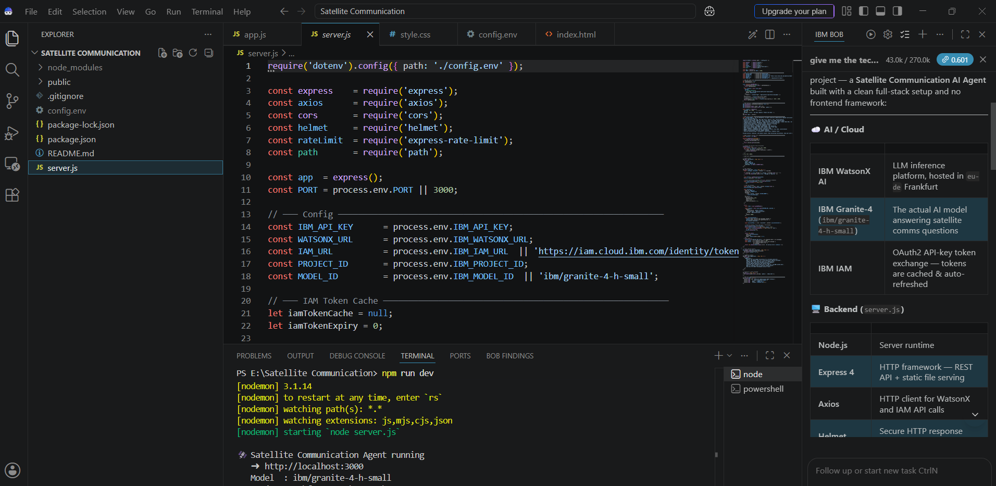
IBM Bob Screenshots:

Slide 8
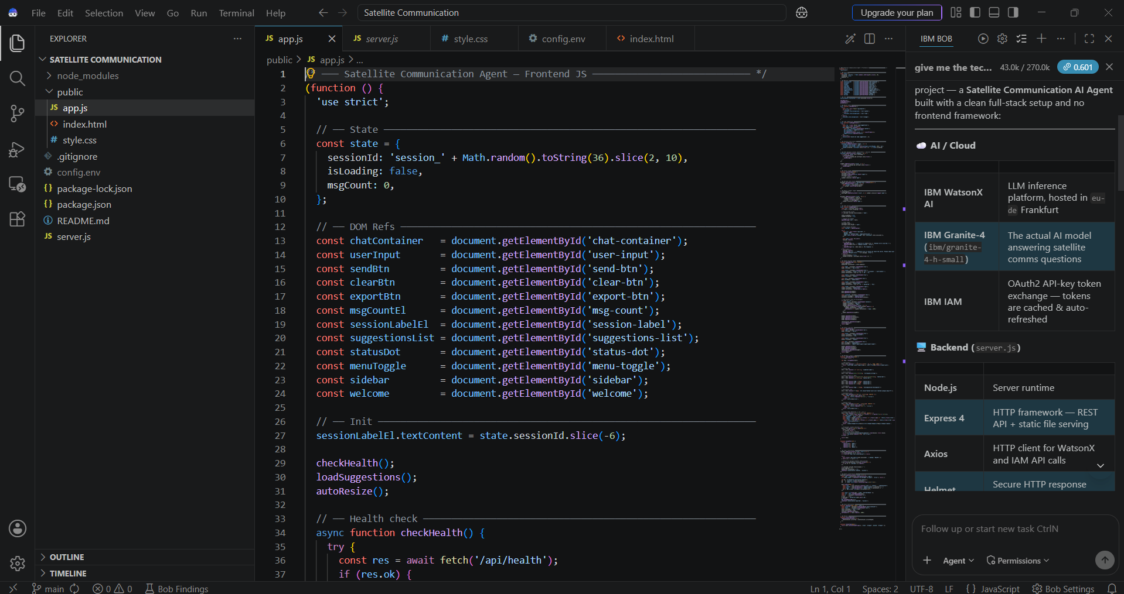

Slide 9
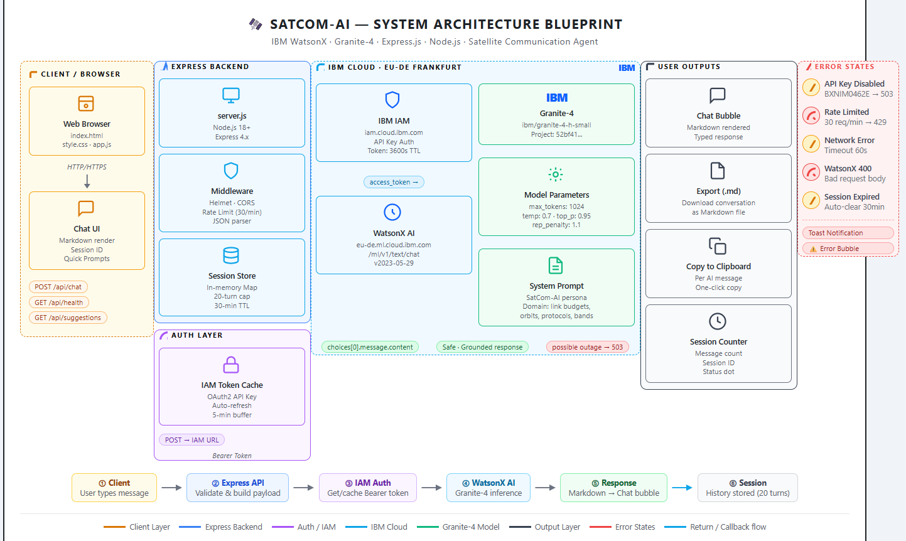
Architecture blueprint for IBM bob:

Slide 10

Role of Agentic AI in the solution
Role of Agentic AI in Satellite Communication Agent
Understands User Intent – Interprets user queries and identifies the required satellite communication concept.
Intelligent Knowledge Retrieval – Retrieves the most relevant information from the knowledge base using RAG.
Context-Aware Responses – Generates accurate, easy-to-understand explanations based on the retrieved content.
Troubleshooting Assistance – Analyzes communication issues and provides step-by-step guidance to resolve them.
Interactive Decision Support – Maintains conversational context and delivers personalized responses for an enhanced learning experience.

Slide 11
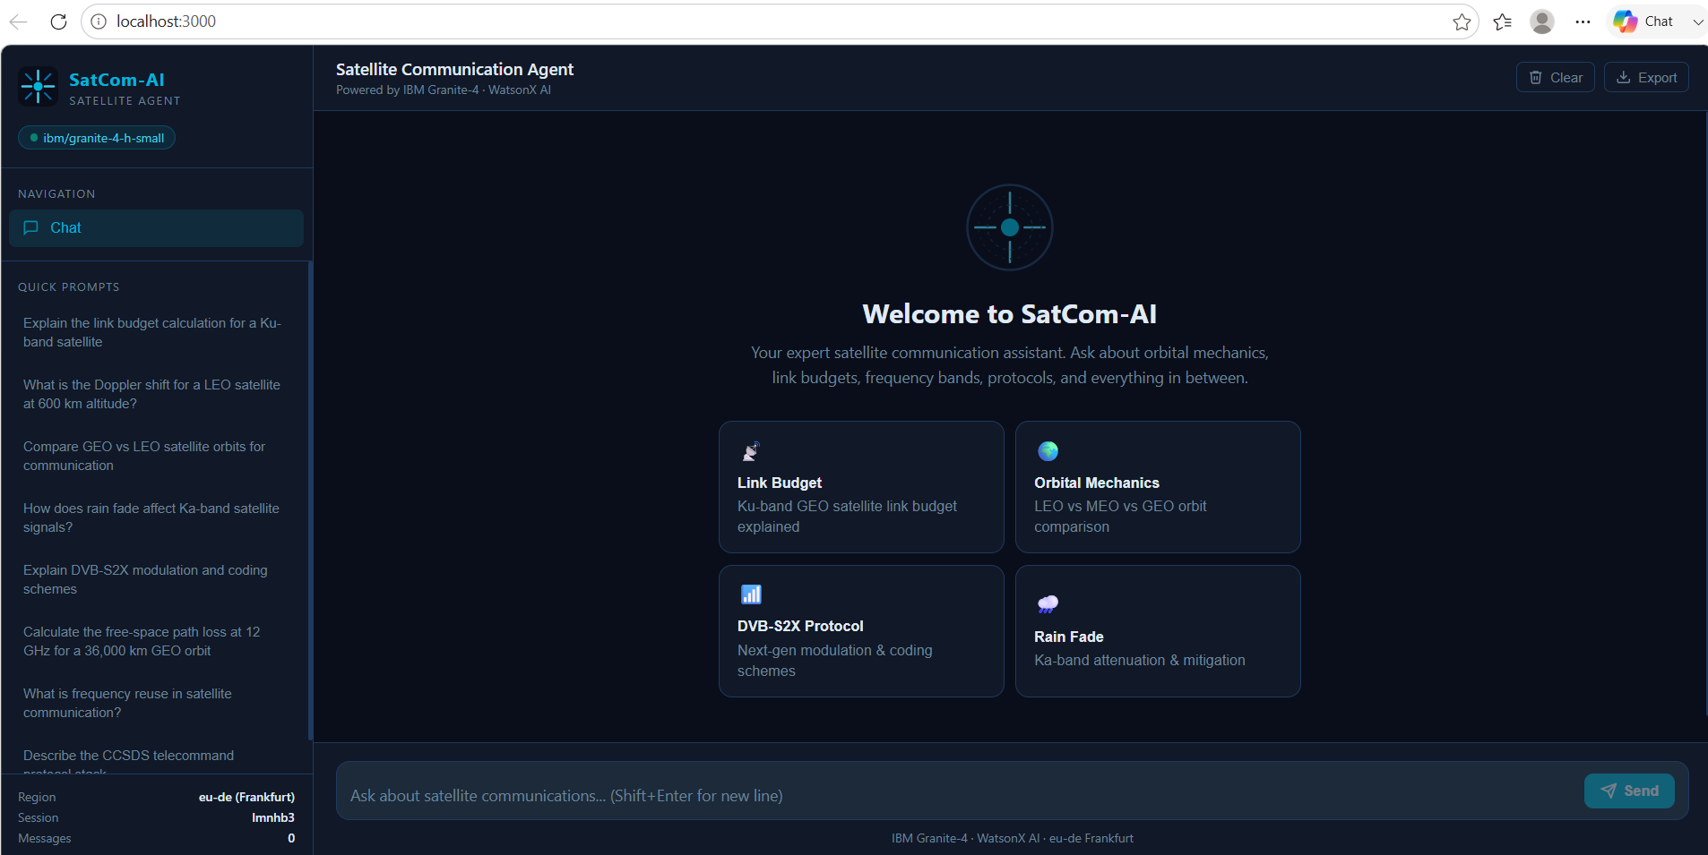
Project Output Screenshot
·
·
·

Slide 12
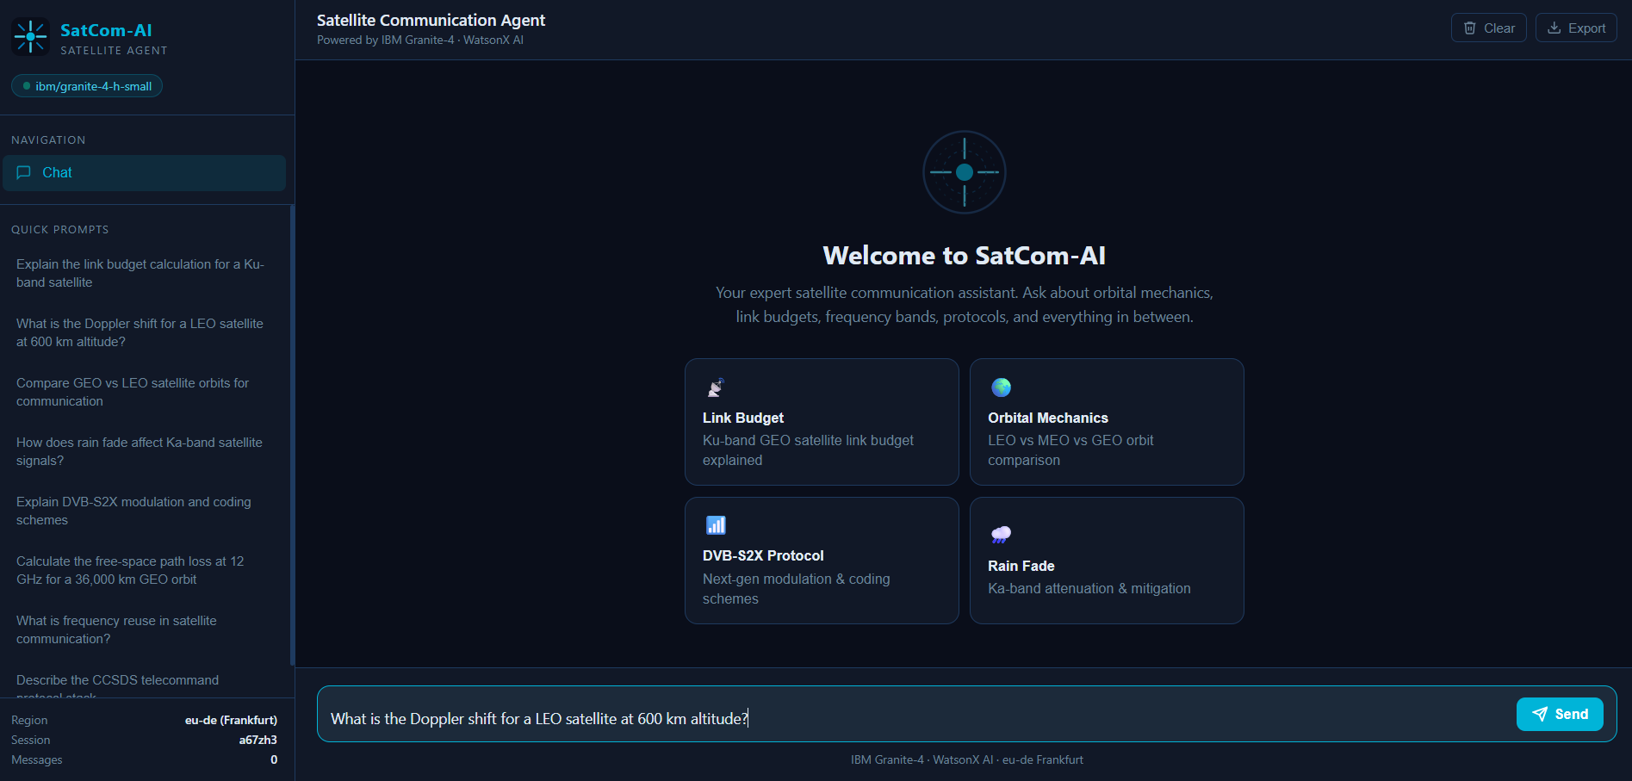
Project Output Screenshot
·
·
·

Slide 13
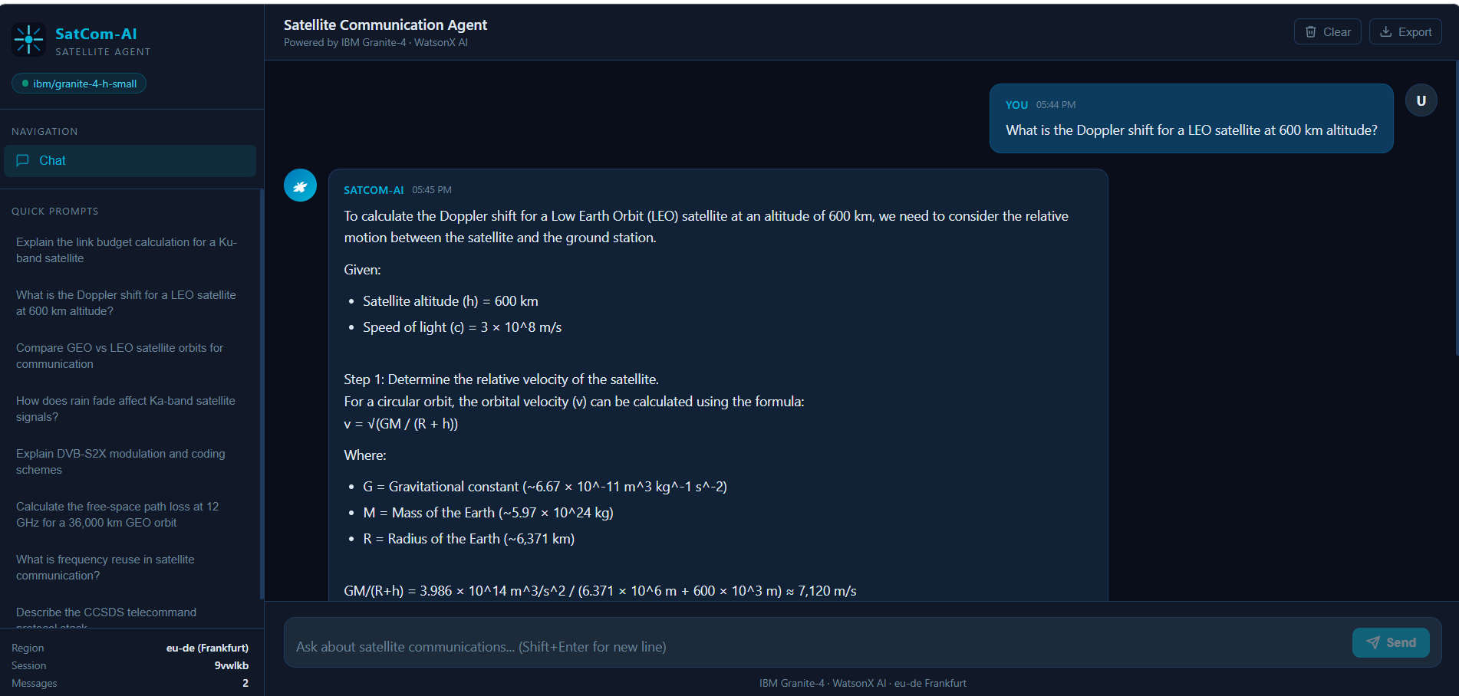
Project Output Screenshot
·
·
·

Slide 14
Novelty and Uniqueness
AI-Powered Learning Assistant - Uses IBM Granite-4 and WatsonX AI to deliver intelligent, context-aware responses instead of static information.
Technical Knowledge in Simple Language - Converts complex satellite communication concepts into easy-to-understand explanations for learners and professionals.
Interactive Conversational Experience - Users can ask questions naturally and receive instant, personalized answers through a chat interface.
Knowledge + Troubleshooting in One Platform - Combines concept learning with practical troubleshooting guidance, reducing the need to consult multiple resources.
Fast & Efficient Information Retrieval - Quickly accesses relevant satellite communication knowledge, saving time compared to searching manuals and research papers.

Slide 15
Git Hub Link
Github URL – https://github.com/bhavana-2203/Smart-Satellite-Communication

Slide 16
Future Scope
Expand Knowledge Base - Integrate more satellite communication standards, research papers, and technical documentation.
Real-Time Satellite Data - Connect with live satellite telemetry and tracking APIs for up-to-date information.
Multilingual Support - Enable users to interact with the assistant in multiple languages.
Voice-Based Assistant - Add speech recognition and text-to-speech for hands-free interaction.
Advanced Analytics & Simulations - Include satellite link budget calculators, orbital simulations, and performance visualization tools.

Slide 17
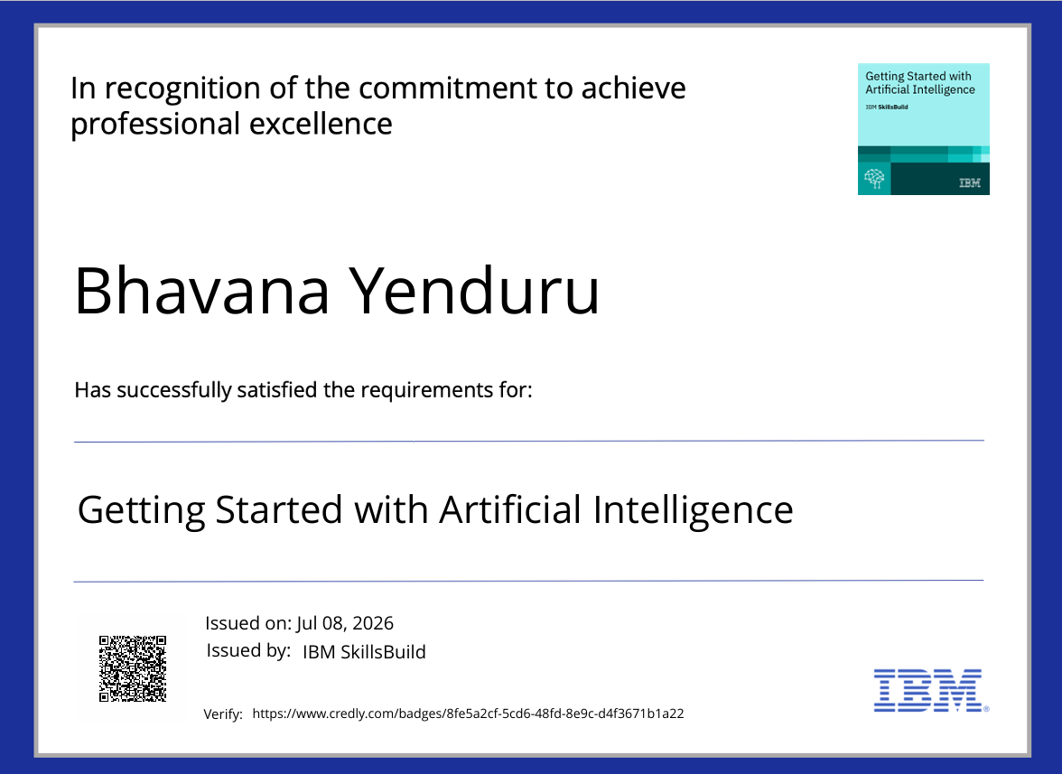
Certificates Earned:

Slide 18
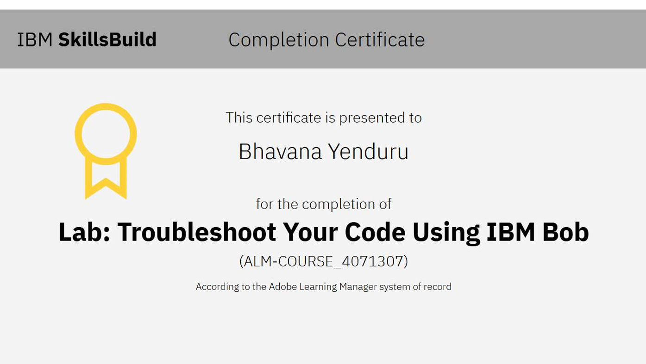
Certificates Earned:​

Slide 19
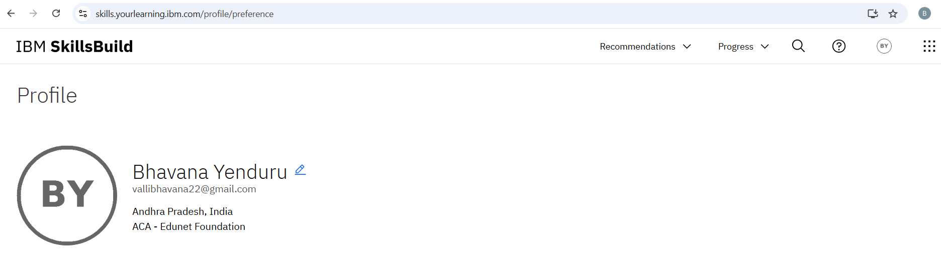
IBM SKILLSBUILD PROFILE
https://skills.yourlearning.ibm.com/profile/preference

Slide 20


